Slide 1
Fantasy Soccer
Team 3
Eric Smyth (SE A)
Brian Fish (SE B)
Yong Shin (SE C)

Slide 2
Introduction
Our Project: What are Fantasy Sports?
Motivation
  Fantasy sports are data driven
  Revenue driver for leagues and websites
  Soccer is the most popular game in the world
Purpose
  Create a backend system for a fantasy soccer site

Slide 3
Objective
Previous works/Related technologies
  Yahoo Sports, ESPN.com
  Professional leagues (nfl.com, premierleague.com)
Objective
  Deliver the back end of a soccer fantasy league, with proof of concept sample data
  Provide a framework that could be re-used for other fantasy sports

Slide 4
Our Approach
Divide and conquer
MySQL
  Primary focus
Microsoft SQL-Server
  Developed for experience with the product

Slide 5
Methodology
Database System Development Lifecycle of Connolly and Begg.
5 Phases:
  Database Planning
  System Definition Requirement Collection and Analysis
  Conceptual Model
  Logical Model
  Physical Model

Slide 6
Database Planning
Mission Statement
  The purpose of the Fantasy Soccer database is to deliver the back end of a soccer fantasy league which allows users to create and manage fantasy soccer teams and fantasy soccer leagues.
Mission Objectives
  Create and manage user data.
  Create and manage fantasy soccer teams.
  Create/Join and manage fantasy soccer leagues.
  Browse and maintain player statistics.
  Browse team rankings.

Slide 7
System Definition
Main Actors and Roles (User Views)
  Team Manager: Creates and manages fantasy soccer team.
  League Commissioner: Creates and manages fantasy soccer league.
  System Administrator: Uploads game data; maintains system.
  User/Viewer

Slide 8
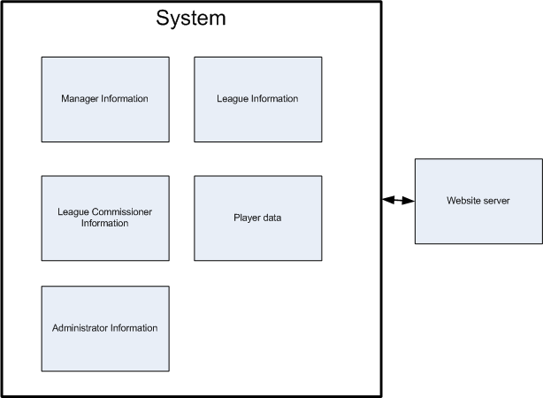
System Boundary

Slide 9
Requirements Collection and Analysis
Fact-Finding Techniques:
  Research/Interview
  Participate in existing Fantasy Soccer Leagues.
    http://fantasy.premierleague.com/
    http://uk.premiership.fantasysports.yahoo.com/

Slide 10
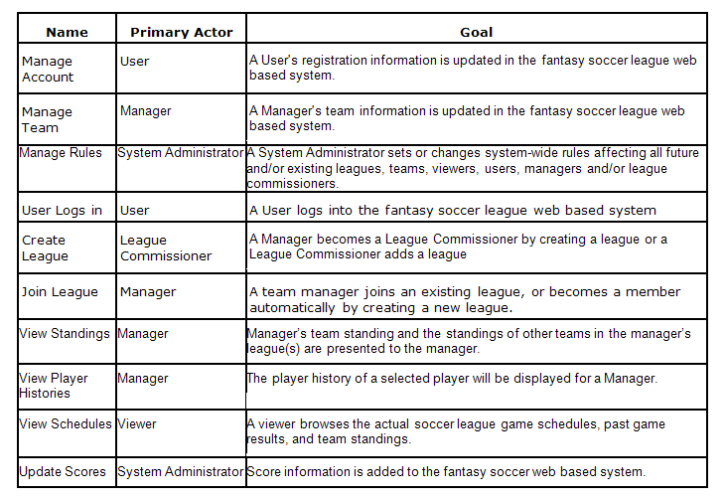
Use Case Summary

Slide 11
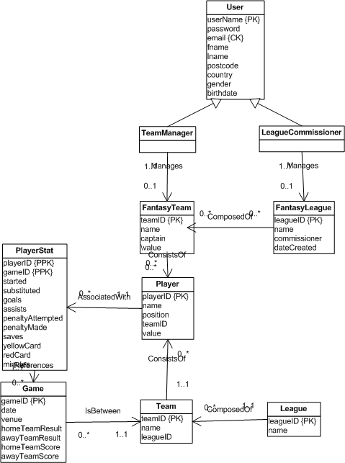
Conceptual Model (Team Manager View)

Slide 12
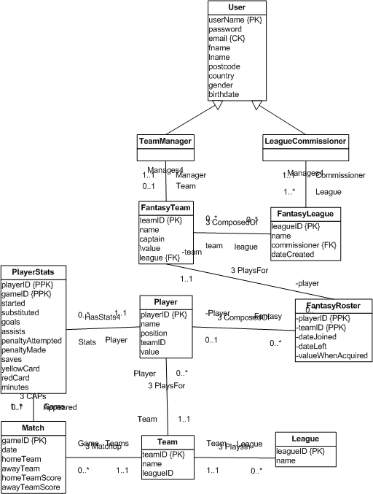
Conceptual Model (League Commissioner View)

Slide 13
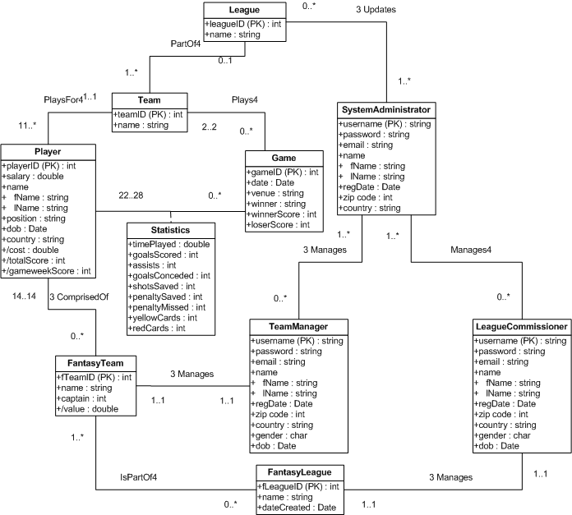
Conceptual Model (System Administrator View)

Slide 14
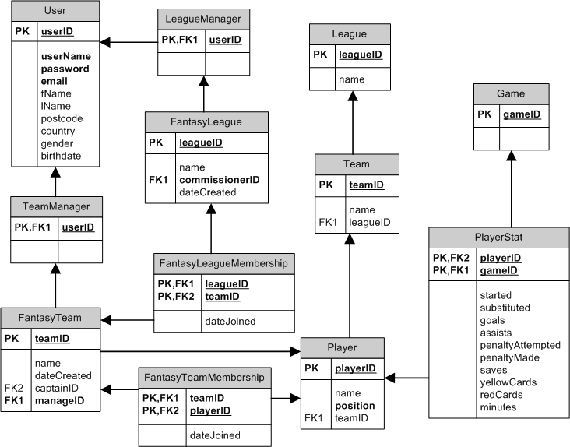
Logical Model (Team Manager View)

Slide 15
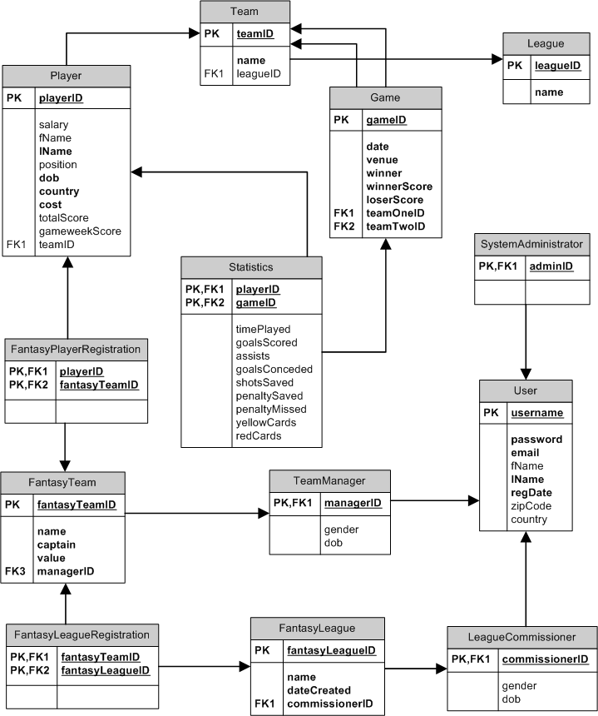
Logical Model (League Commissioner View)

Slide 16
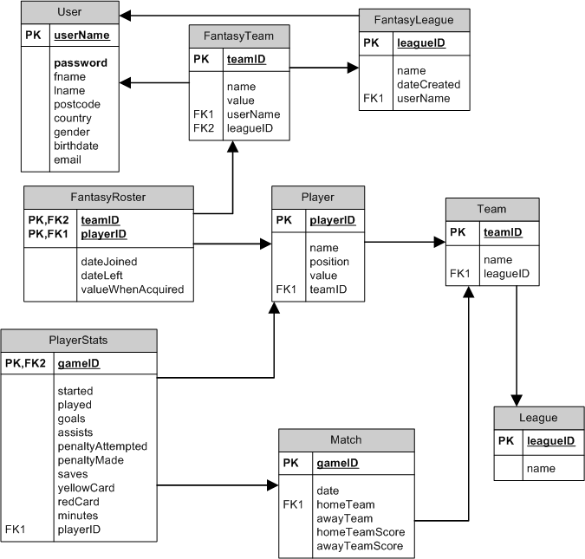
Logical Model (System Administrator View)

Slide 17
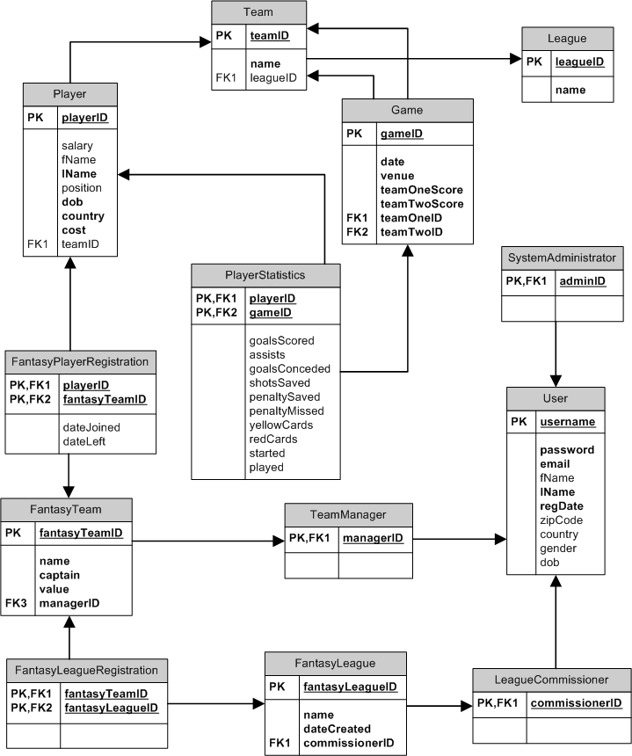
Global Logical Model

Slide 18
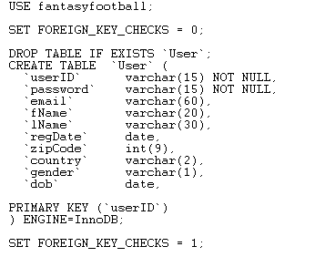
Physical Model
DDL for the User relation in mySQL 5 and MS SQL Server 2005
USE [fantasyfootball]
CREATE TABLE [dbo].[User](
[userID] [varchar](15) NOT NULL,
[password] [varchar](15) NOT NULL,
[email] [varchar](60) NULL,
[fName] [varchar](20) NULL,
[lName] [varchar](30) NULL,
[regDate] [datetime] NULL,
[zipcode] [int] NULL,
[country] [varchar](20) NULL,
[gender] [varchar](1) NULL,
[dob] [datetime] NULL,
CONSTRAINT [PK_User] PRIMARY KEY CLUSTERED
(
[userID] ASC
)WITH (PAD_INDEX = OFF, STATISTICS_NORECOMPUTE = OFF, IGNORE_DUP_KEY = OFF, ALLOW_ROW_LOCKS = ON, ALLOW_PAGE_LOCKS = ON) ON [PRIMARY]
) ON [PRIMARY]

Slide 19
Testing
Enforcement of primary key uniqueness
Modifications comply with have/maintain required attributes
Referential integrity is maintained on updates and deletions
SQL statement to delete the English Premier League
delete from League where leagueID = 1;
League relation before execution
"1" "English Premier League"
"2" "Spanish La Liga"
"3" "Spanish Segunda"
"4" "Italian Serie A"
"5" "Italian Serie B"
"6" "German Bundesliga 1"
"7" "German Bundesliga 2"
"8" "French Ligue 1"
"9" "French Ligue 2"
"10" "Scottish Premier League"
"11" "Dutch Eredivisie"
Relationship:
Team(leagueID) references League(leagueID) ON UPDATE CASCADE ON DELETE SET NULL
League relation post execution
"2" "Spanish La Liga"
"3" "Spanish Segunda"
"4" "Italian Serie A"
"5" "Italian Serie B"
Team relation post execution
"1" "Arsenal" \N
"2" "Aston Villa" \N
"3" "Birmingham" \N
"4" "Blackburn" \N

Slide 20
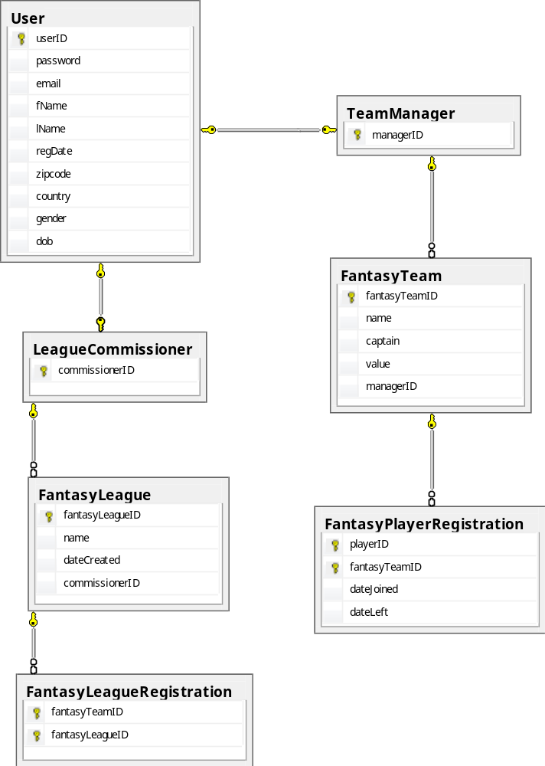
Fantasy League Membership View
View DML
DROP VIEW IF EXISTS `ecsmyth`.`FantasyLeagueMembership`;
create view FantasyLeagueMembership (fLeagueName, commissionerName, fTeamName, managerName)
as select fl.name, u.lName, ft.name, su.lName
from FantasyTeam ft, FantasyLeague fl, FantasyLeagueRegistration flr, LeagueCommissioner lc, User u, User su, TeamManager tm
where ft.fantasyTeamID = flr.fantasyTeamID && fl.fantasyLeagueID = flr.fantasyLeagueID && fl.commissionerID = lc.commissionerID && lc.commissionerID = u.userID && tm.managerID = su.userID && ft.managerID = tm.managerID;
select * from FantasyLeagueMembership where fLeagueName=‘UW:T’
"UW:T" "Eide" "South Sound Rangers" "Mattson"
"UW:T" "Eide" "Bellevue FC" "Educalane"
"UW:T" "Eide" "Bellingham FC" "Eide"
"UW:T" "Eide" "Shadwell Army" "Johnson"

Slide 21
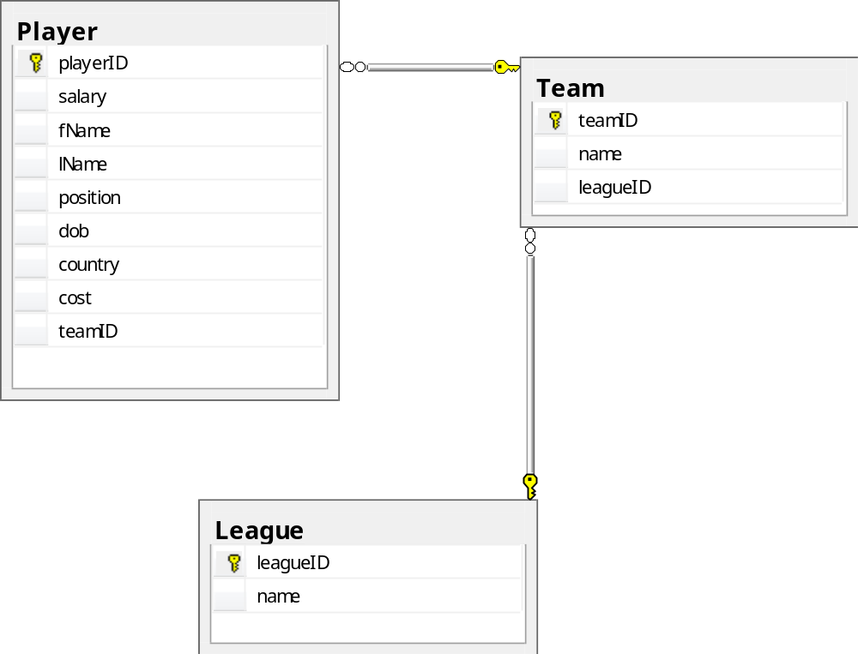
Team Player Summary View
View DML
DROP VIEW IF EXISTS `ecsmyth`.`TeamPlayerSummary`;
create view TeamPlayerSummary(leagueName, teamName, playerLName, pos)
as select l.name, t.name, p.lName, p.position
from Team t, Player p, League l
where p.teamID = t.teamID && t.leagueID = l.leagueID;
select * from TeamPlayerPosition where teamName='Arsenal';
"English Premier League" "Arsenal" "Lehmann" "Go"
"English Premier League" "Arsenal" "Fabianski" "Go"
"English Premier League" "Arsenal" "Toure" "De"
"English Premier League" "Arsenal" "Gallas" "De"
"English Premier League" "Arsenal" "Eboue" "De"
"English Premier League" "Arsenal" "Clichy" "De"
"English Premier League" "Arsenal" "Sagna" "De"
"English Premier League" "Arsenal" "Senderos" "De"

Slide 22
Conclusions
The Fantasy Soccer system exceeds expectations of a fantasy soccer league
If the system is fully developed it will serve as the basis for a robust fantasy soccer league with the ability to port to other sports
The system is cheap, efficient, and accurate.
Our design has been validated through the iterative use of the DSDLC
Standard design patterns have been implemented to facilitate deployment and maintenance

